Slide 1


Charge Injection System (CIS) Update
Katie Hughes, Dawit Belayneh
The University of Chicago
June 16, 2022

Slide 2
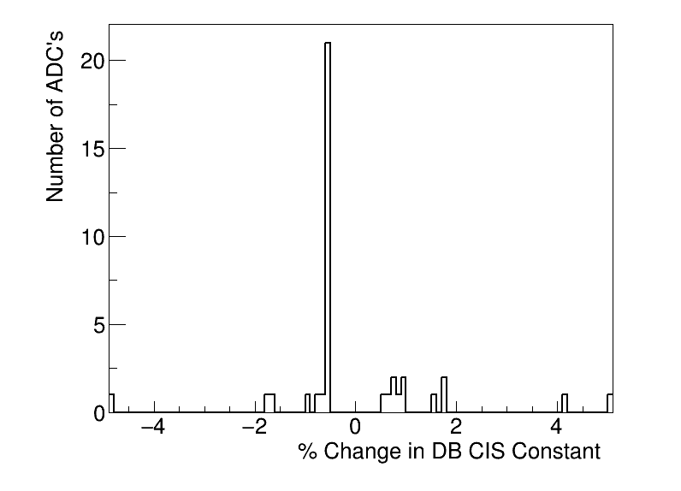
Summary
CIS runs from May. 1 - June. 1
Database updated June 13-14
39 channels in update
19 Good
2 >5% change
5 Masked
15 Affected
Notes:
Channels in update is much larger than usual (~125)

Slide 3
Run Selection
LBA has a history of bad Amp/Q ratios – why?
In this update, 8/13 CIS runs have some problem with LBA (mostly lowgain):
Same was true in last update, the only partition with bad Amp/Q ratio was LBA.
Run # | 419864 | 420384 | 420709 | 421222 | 421606 | 422100 | 422198 | 422233 | 422268 | 422529 | 422767 | 423123 | 423287
Bad Amp/Q | LBA LG |  |  |  | LBA LG |  | LBA both | LBA HG |  | LBA LG | LBA LG | LBA HG | LBA LG
Bad Timing |  |  |  |  |  |  | LBA LG |  |  | LBA LG
Notes:
419864 420384 420709 421222 421606 422100 422198 422233 422268 422529 422767 423123 423287

Slide 4
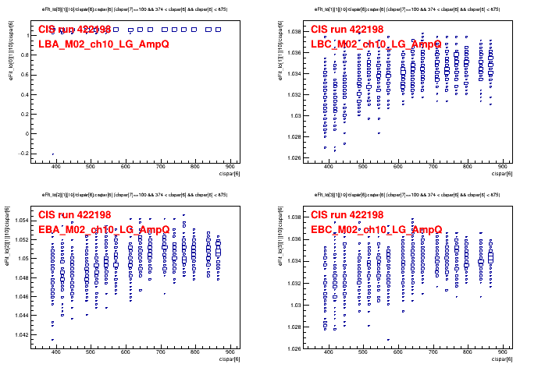
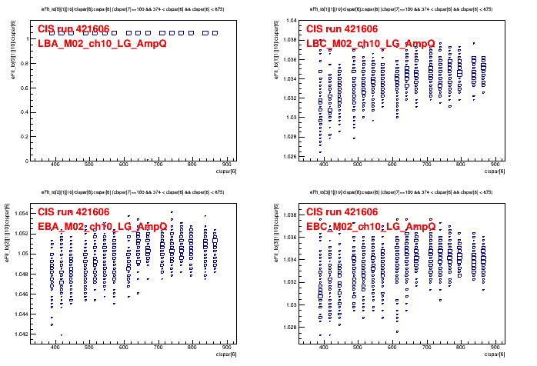
Run Selection
These plots show LBA02_ch10, but I tried with 2 other module/channel combinations to ensure that it was not a single channel issue (and confirmed the problem there too)

Slide 5
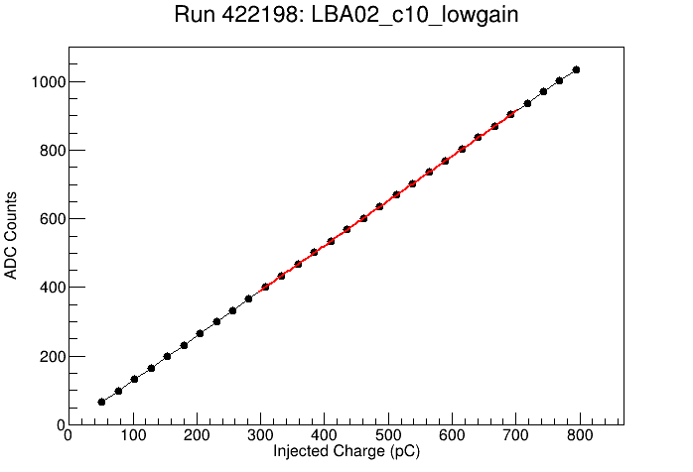
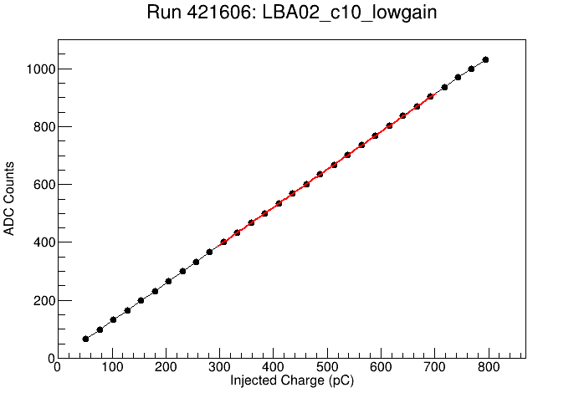
Run Selection
Corresponding CIS fit plots for bad amp/Q runs in previous slide

Slide 6
Run Selection
Since this affected so many runs, I ran a separate CIS update only over LBA with the 5 “good” runs and compared the values from the two updates.
This would only change the value of 4 channels in LBA and by marginally small amounts. 3/4 of these are also BadCIS anyways.
LBA_m37_c21_highgain: 75.339699 → 75.531136
LBA_m51_c12_highgain: 78.736748 → 78.828972
LBA_m56_c00_highgain: 82.601662 → 82.603943
LBA_m64_c29_highgain: 74.67939 → 74.695496
The bad Amp/Q does not seem to have an effect on the CIS constant. So I have left these runs in for this CIS update to have a greater number of points for the calculation.
Run list: 419864 420384 420709 421222 421606 422100 422198 422233 422268 422529 422767 423123 423287

Slide 7
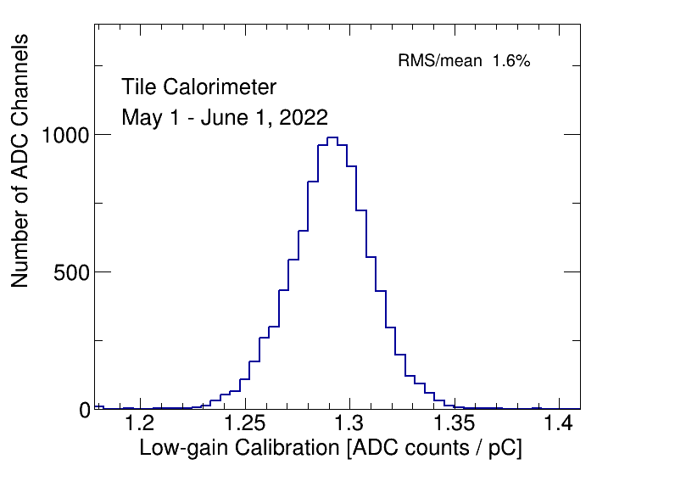
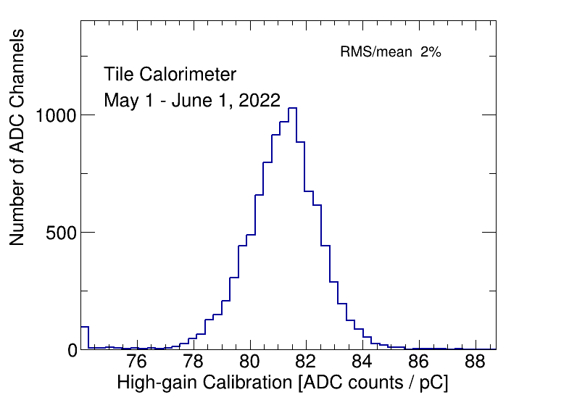
CIS constant distributions

Slide 8
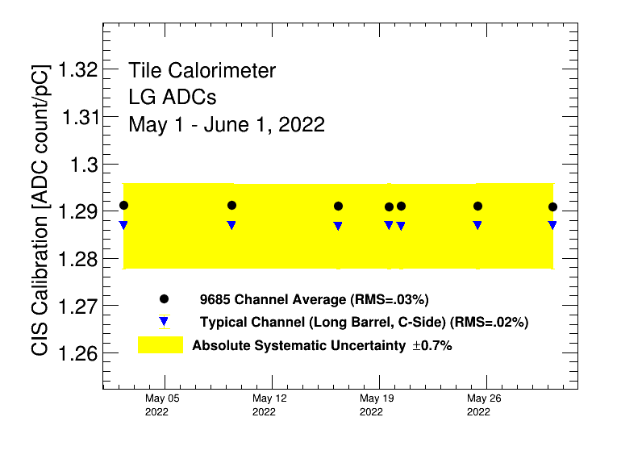
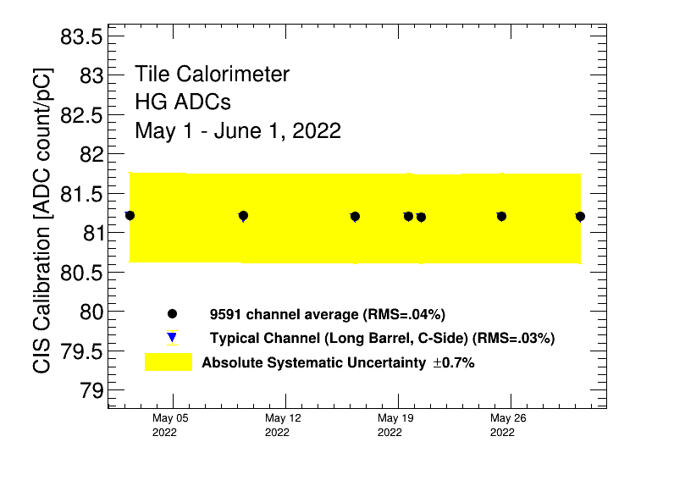
Detector Time Stability

Slide 9
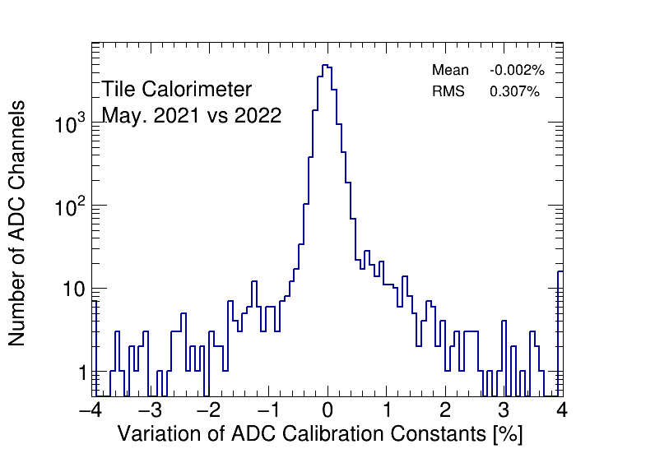
CIS constant stability

Slide 10
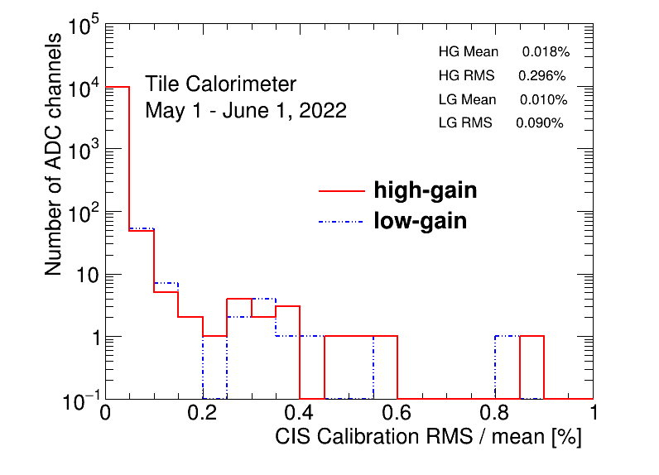
CIS constant RMS/mean

Slide 11
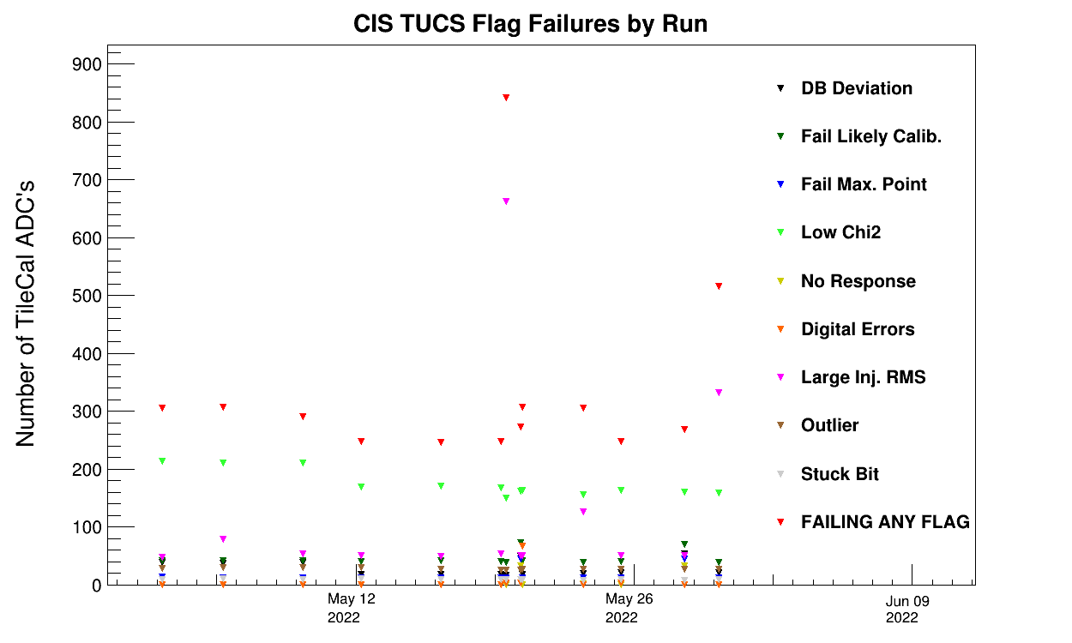
CIS TUCS Quality Flags
Run # 422198
Bad timing for LBA LG
Bad Amp/Q for LBA LG + HG
Run # 423287
Bad Amp/Q for LBA LG
Notes:
**** which run is it that has the problems???

Slide 12
Interesting channel behaviour

Slide 13
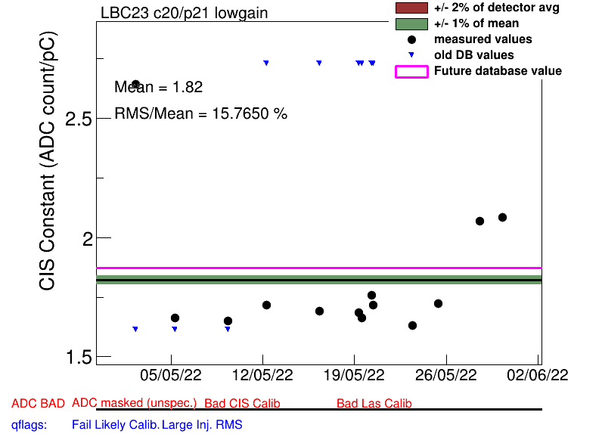
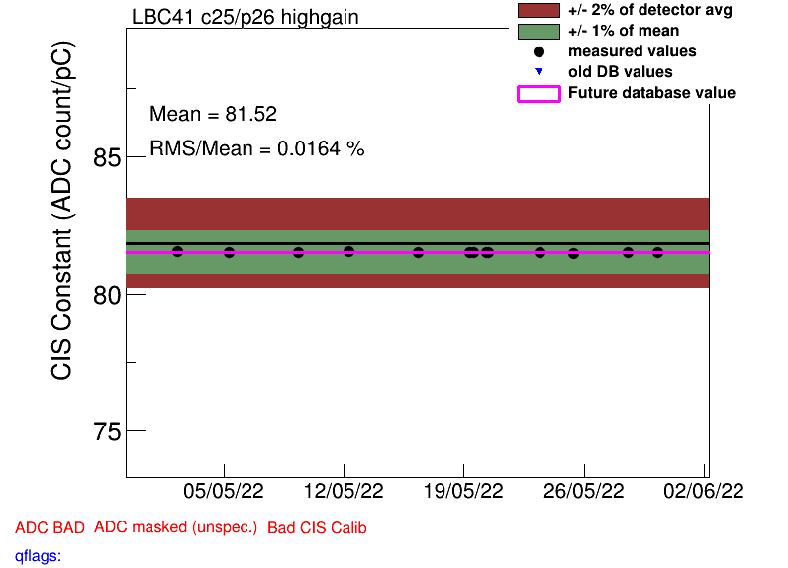
High Deviation from DB Mean (2)
LBC_m23_c20_lowgain 2.73 1.87 -31.41%
LBC_m41_c25_highgain 44.49 81.52 83.20%
Was at half gain at the beginning of April, switched to this value at April 14. I performed a manual recalibration of the channel last update, but the value somehow did not make it into the final sqlite.

Slide 14
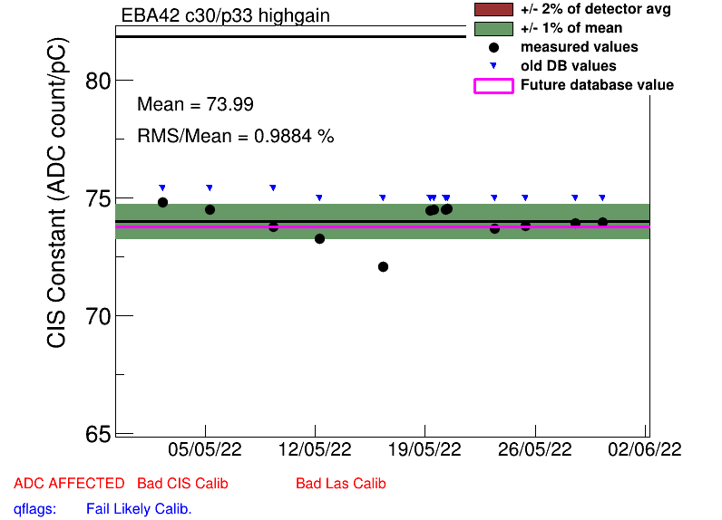
Some High Scatter Channels
EBA_m42_c30_highgain
EBC_m13_c03_lowgain
EBC_m20_c10_lowgain
EBC_m22_c16_lowgain
LBA_m37_c21_highgain
LBC_m10_c37_highgain
LBC_m16_c29_highgain
LBC_m23_c20_lowgain
LBC_m43_c24_highgain
LBC_m44_c12_highgain
LBC_m52_c18_highgain

Slide 15
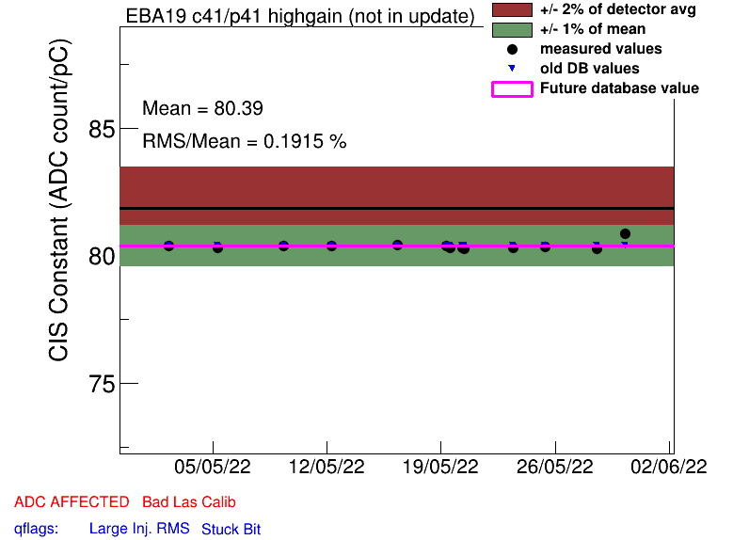
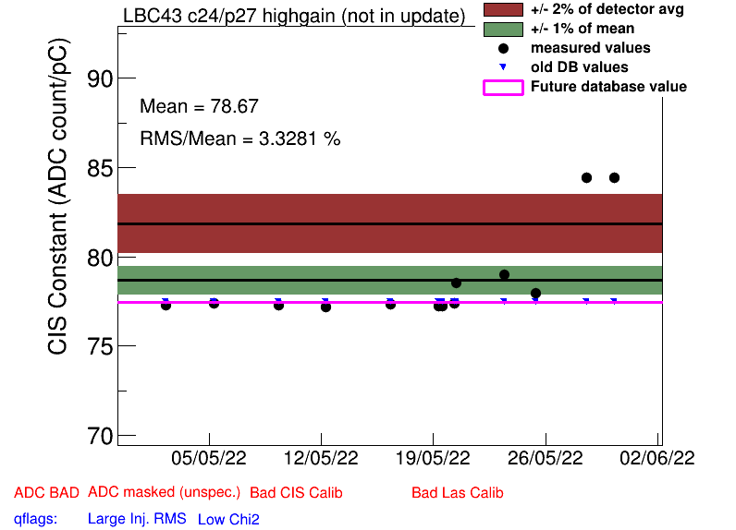
Drifting Channels
EBA_m19_c41_highgain
LBC_m43_c24_highgain

Slide 16
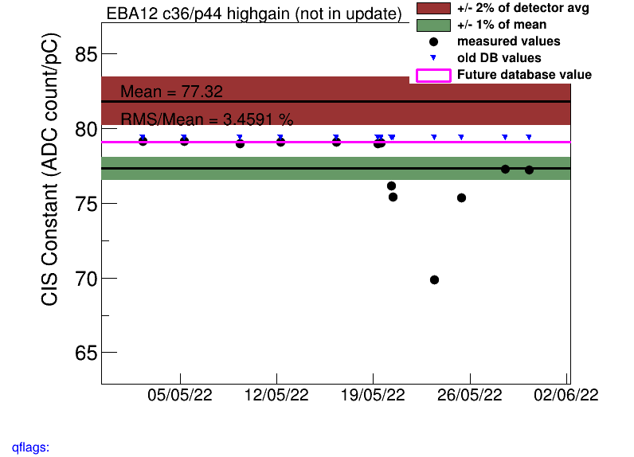
Spikes: EBA_m12_c36_highgain

Slide 17
Spikes: EBA_m12_c36_highgain

Slide 18
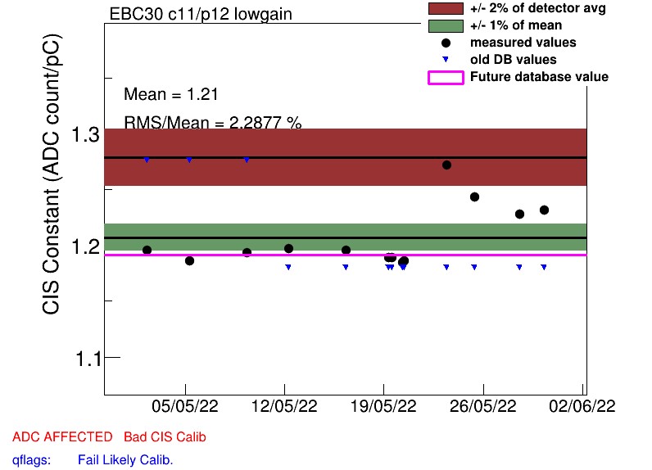
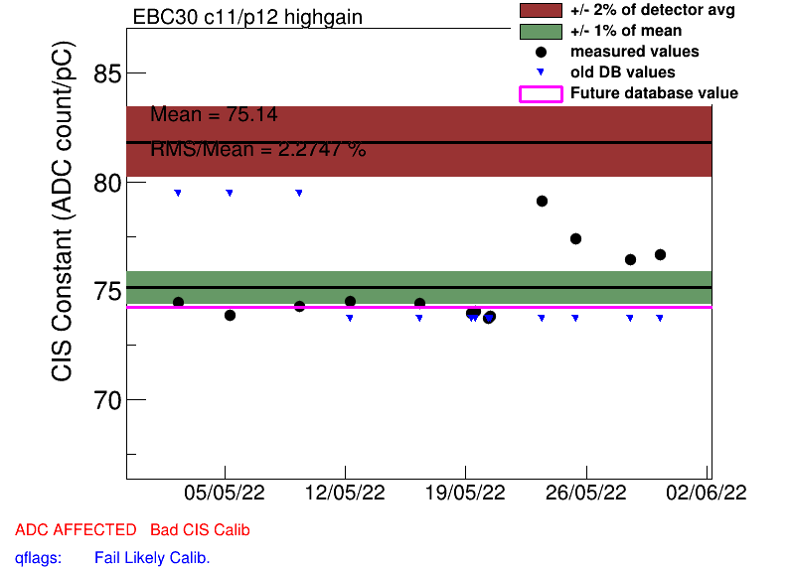
Spikes: EBC_m30_c11 (both gains)

Slide 19
Spikes: EBC_m30_c11 (both gains)

Slide 20
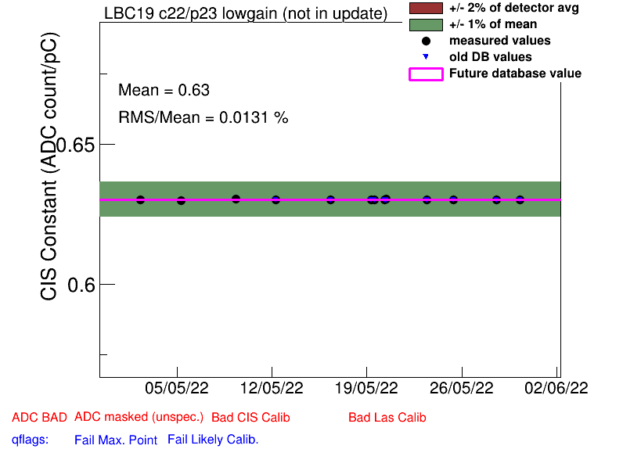
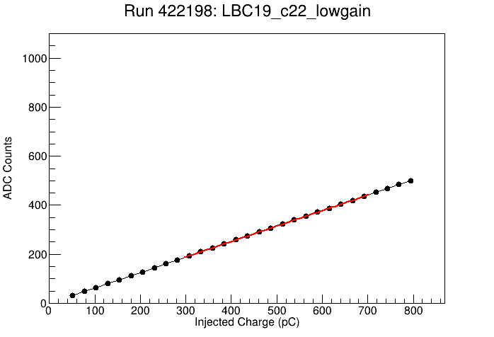
Half Gain Channels
EBA_m15_c08_highgain
EBA_m16_c00_highgain
EBA_m36_c15_highgain
EBA_m48_c31_lowgain
EBA_m64_c03_highgain
EBC_m09_c40_highgain
EBC_m21_c36_lowgain
LBA_m37_c19_highgain
LBC_m08_c03_lowgain
LBC_m19_c22_lowgain
Switched to half gain last month, stayed at the same level this month

Slide 21
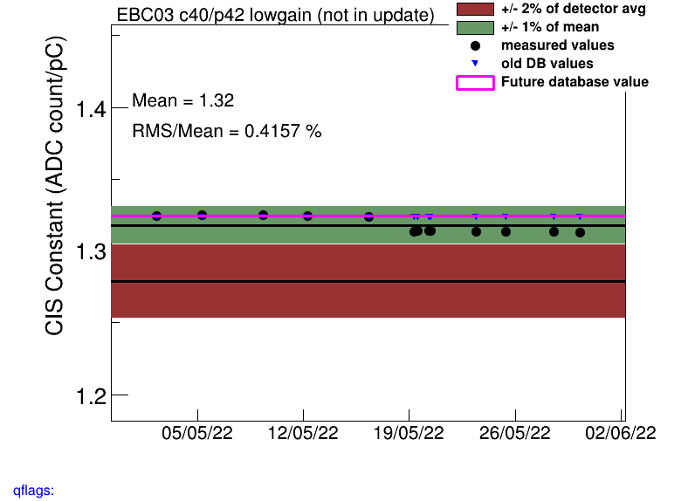
Manual Recalibrations
EBC_m03_c40_lowgain
EBC_m16_c39_highgain
EBC_m56_c41_lowgain
LBA_m45_c06_highgain
LBA_m51_c12_highgain
LBA_m52_c01_lowgain
LBC_m28_c04_lowgain
LBC_m44_c12_highgain
LBC_m57_c06_highgain

Slide 22
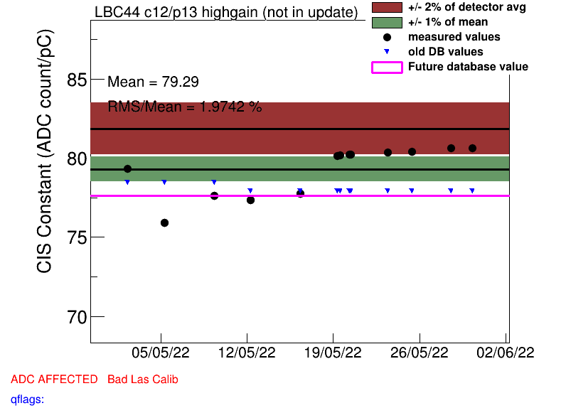
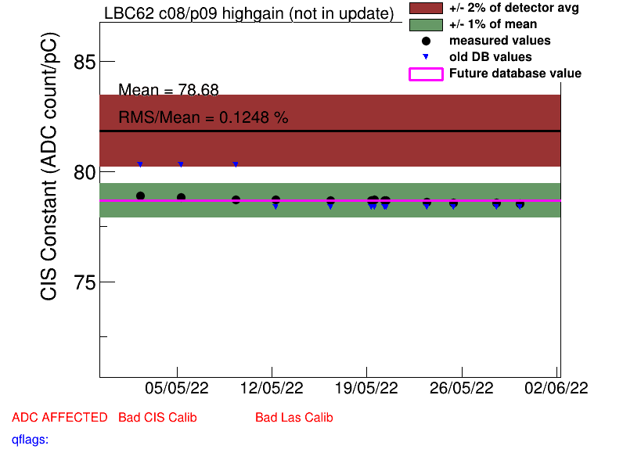
COOL Flag Updates
Remove BadCIS (6)
LBA_m02_c06_lowgain
LBA_m03_c17_lowgain
LBC_m28_c04_lowgain
LBC_m41_c25_highgain
LBC_m57_c06_highgain
LBC_m62_c08_highgain
Add BadCIS (4)
EBA_m12_c36_highgain
EBA_m19_c41_highgain
LBC_m10_c37_highgain
LBC_m44_c12_highgain

Slide 23
